Slide 1
Raw Talent vs TalentNow
Competitive Intelligence Report
Strategic Analysis & South Australia Growth Plan
Prepared by: Joy Victoria, Business Consultant
Date: June 2026 · Version 1.0 · CONFIDENTIAL
Notes:
Cover slide. Presenter: introduce the purpose — this is an analysis of how TalentNow competes with Raw Talent and what SA growth actions we should take.

Slide 2
EXECUTIVE SUMMARY
Three Things We Need to Know
01
02
03
The TalentNow Connect model is architecturally better for WRP
Raw Talent's Edge SA win is a time-sensitive supply problem
Raw Talent's human advantage is defensible — but only if we act
Their $30/shift marketplace model lets centres employ educators directly — making them WRP-eligible. This is structurally cheaper than any traditional agency and Raw Talent currently has no equivalent offer.
Edge confirmed us as priority agency. The risk is not competition — it's supply. We don't have enough active, compliant SA educators to fill the volume Edge will generate. This must be fixed now.
Centre visits, personal relationships, and SA-specific compliance knowledge are things TalentNow cannot replicate from NSW. But TalentNow is 8 years ahead in technology. We must close the operational gaps urgently.
Sources: TalentNow.com.au | ACECQA | ACA Worker Retention Payment | Raw Talent internal data | Joy Victoria analysis, June 2026
Notes:
Three key findings. Emphasise finding 02 — Edge SA is the most urgent commercial opportunity but requires immediate supply action.

Slide 3
COMPETITOR PROFILE
Who Is TalentNow?
Founded
2018 by Liddy Korner, Mosman NSW
8
Years operating (2018–2026)
Reach
National — all states and territories
Self-described
"Uber of childcare" — first app-based ECEC staffing in Australia
2
Distinct products (Connect + Casual Hire)
Ownership
Independent — not owned by any childcare provider
$30
App
Free iOS + Android — educators sign up in minutes
Flat booking fee per shift (Connect model)
Contact
1800 840 889 · info@talentnow.com.au
National
Educator pool across all AU states
Source: TalentNow.com.au | TheSector.com.au (Feb 2025) — 'Talent Now utilises Employment Hero integration to better serve ECEC services'
Notes:
TalentNow profile. Key point: 8 years old, national, independent. They have significant head start on us in technology and market presence outside SA.

Slide 4
BUSINESS MODEL
TalentNow Has Two Models — We Only Have One
TalentNow CONNECT
TalentNow CASUAL HIRE
Raw Talent (Current)
Who employs educator
Childcare Centre
(educator is their casual employee)
TalentNow
(agency model)
Raw Talent
(agency model)
Cost to centre
$30 flat fee per shift
(any qualification, any duration)
Agency charge rate
(educator pay + margin)
Agency charge rate
(educator pay + margin)
WRP eligible?
YES — centre accesses
government WRP grant directly
Complex — agency
must enroll separately
Via WRP toggle
for enrolled centres
Payroll managed by
Centre (Employment Hero automates setup)
TalentNow
Raw Talent
Admin for centre
Low — Employment Hero
integration handles setup
Very Low — TN
handles everything
Very Low — RT
handles everything
⚠ Biggest competitive threat
Source: TalentNow.com.au/early-childhood-centres | TheSector.com.au (Feb 2025) | ACA Worker Retention Payment FAQ | Joy Victoria analysis, June 2026
Notes:
This is the most important slide. TalentNow Connect is fundamentally different — centres become employers, pay $30/shift, and keep WRP. We don't have this model.

Slide 5
PAY RATE ANALYSIS
The SA Pay Gap — Why Educators Are Choosing Competitors
Current Pay Gap
$4–5/hr
RT vs Entrée in SA
WRP Uplift
+10%
from Dec 2024 (Yr 1)
Gender Uplift (FWC)
9–28%
proposed from Jan 2026
RT with WRP Toggle
~$46.20
per hour (competitive)
Sources: Children's Services Award 2010 [MA000120] | ACA WRP Wage Calculator (aca-worker-retention-payment.org.au) | VECTEA Salary Guide 2026 | Raw Talent internal data | Competitor intel from educator re-engagement calls SA, June 2026. Note: TalentNow Casual Hire rate is estimated; exact rate not publicly disclosed.
Notes:
The $4-5/hr gap is the primary reason SA educators choose Entrée over RT. The WRP toggle, once activated for enrolled SA centres, closes this gap entirely. Action: get profitability model done and activate toggle.

Slide 6
REGULATORY
Worker Retention Payment (WRP) — What It Is & Why It Matters
What is the WRP?
TalentNow CONNECT
The WRP is a Federal Government grant running 2 December 2024 — 30 November 2026. It funds a 10% wage increase in Year 1 for eligible ECEC workers. The grant goes to approved centres, who must pass it on to their eligible employees. Further increases are legislated for Dec 2026 (+10%), Jul 2028 (+5%), and Jul 2029 (TBD).
Educators employed BY the centre → WRP flows directly from centre's own grant → educators get full WRP automatically
Australian
Government
WRP Grant
Funding
Approved
ECEC Centre
Eligible
Educator
Raw Talent (Agency Model)
→
→
→
RT employs educator → WRP toggle available for WRP-enrolled Edge SA centres
Grant flows to centres → centres pass increase to educators
Sources: ACA Worker Retention Payment Support Service (aca-worker-retention-payment.org.au) | Department of Education WRP program | ACA WRP Wage Calculator | TheSector.com.au (Feb 2025) — TalentNow Employment Hero integration article | WRP applications close 30 September 2026
Notes:
WRP is the structural advantage of TalentNow Connect. Key action: confirm Raw Talent WRP enrolment status immediately. WRP ends 30 November 2026 — larger gender uplift increases follow from December 2026 under Fair Work Commission decision.

Slide 7
COMPLIANCE 2026
Australian ECEC Regulatory Changes — What Agencies Must Track
URGENT
Late August 2026
URGENT
Late March 2026
National Child Safety Training
National Early Childhood Worker Register
Mandatory for ALL ECEC workers, volunteers and students from 27 Feb 2026. Does NOT replace SA state Child Protection training or RAN Training. Approved providers face risk if educators are not compliant.
Approved providers must enter all workforce information into the new national register. RT must confirm this is in place for all SA educators.
ACTION
30 September 2026
SA SPECIFIC
Ongoing — check expiry
WRP Application Deadline
SA DCSI Screening (SA Only)
Final deadline to apply. Backdating to 2 December 2024 required applications by 30 September 2025. WRP payments run until 30 November 2026, with further increases legislated from December 2026.
South Australia's Working with Children equivalent. NOT the same as VIC WWCC. Educators cannot work across both SA and VIC without BOTH checks. Raw Talent must track separately.
SA SPECIFIC
Ongoing — check renewal
WAGE REFORM
From January 2026 (est.)
RAN Training (SA Only)
FWC Gender Undervaluation Increase
Responding to Abuse and Neglect — SA legislative requirement separate from national NCS Training. Must be verified for every SA educator before deployment.
Fair Work Commission provisional decision: 9–28% uplift for Children's Services Award classifications. Timeline revised from Aug 2025 to Jan 2026. Affects charge rates and educator pay calculations.
Sources: ACECQA.gov.au (May 2026) | TalentNow 2026 Reform Update — Child Safety Training | ACA WRP Support Service FAQ | Education and Care Services National Regulations | SA Department for Child Protection (DCSI) | SA Department for Human Services (RAN Training) | FWC Children's Services Award provisional determination, 2025
Notes:
TalentNow published a detailed NCS Training guide in February 2026 — they are ahead of RT on regulatory communications. RT must immediately audit all SA educators for NCS Training completion and DCSI Screening currency.

Slide 8
FEATURE COMPARISON
Raw Talent vs TalentNow — Head to Head
Feature | TalentNow | Raw Talent | Advantage
Founded / Experience | 2018 — 8 years | 2016 — 10 years | Raw Talent
Business model | 2 models: Connect + Casual Hire | 1 model: Agency only | TalentNow
National reach | All states and territories | SA and VIC only | TalentNow
SA market depth | Limited — based in NSW | Strong — Edge partnership | Raw Talent
WRP optimisation | Connect model built around WRP | Toggle available | TalentNow
Flat Booking fee option | $30/shift (Connect model) | No — agency rate only | TalentNow
Payroll automation | Employment Hero integration | Employment Hero processing | Raw Talent
Compliance tracking | Automated real-time alerts | Manual review process | TalentNow
Personal relationships | Remote, national scale | Liam's centre visits — SA | Raw Talent
Edge SA partnership | No known partnership | CONFIRMED primary agency | Raw Talent
Pay rate competitiveness | ~$44/hr (est. Casual Hire) | ~$42/hr (gap = $4–5) | TalentNow
Sources: TalentNow.com.au | LinkedIn company profile (Talent Now) | Raw Talent internal data | Edge SA partnership confirmed June 2026 | Joy Victoria analysis, June 2026. Note: TalentNow Casual Hire rate is estimated as exact pricing is not publicly disclosed.
Notes:
Summary table. RT wins on SA relationships and Edge partnership — but TalentNow wins on almost every technology and model dimension. The Edge win is our time-sensitive opportunity to build the SA advantage before TalentNow expands there.

Slide 9
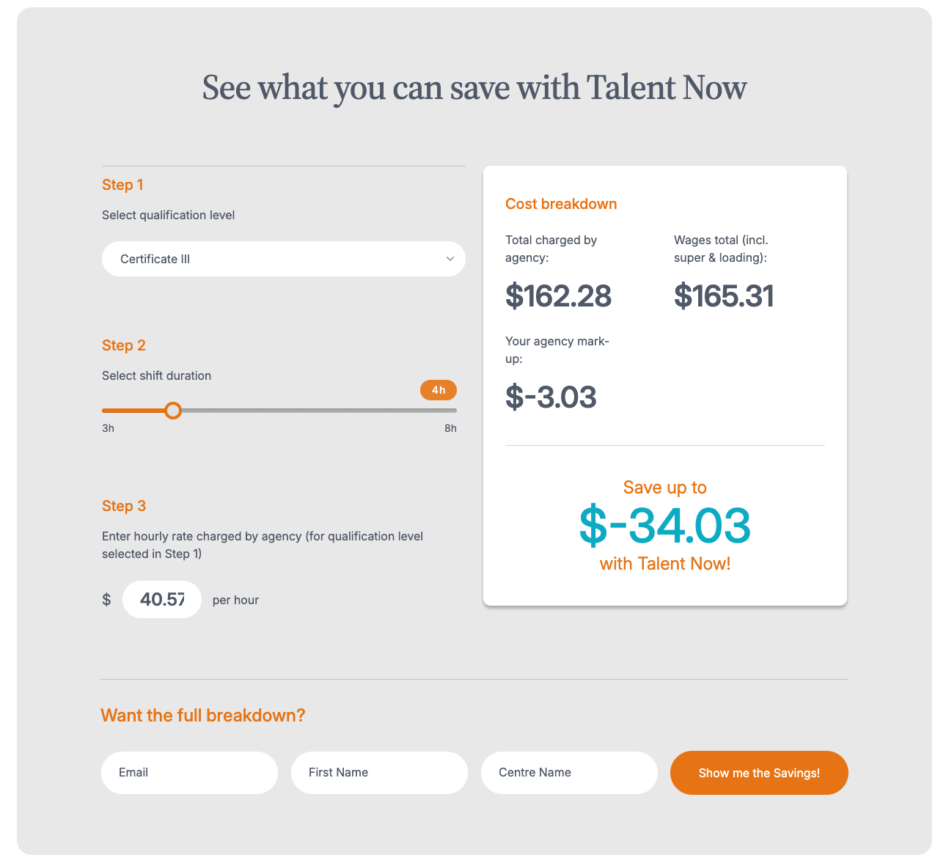

FEATURE COMPARISON
Raw Talent — Online Calculator
Sources: TalentNow.com.au | LinkedIn company profile (Talent Now) | Raw Talent internal data | Edge SA partnership confirmed June 2026 | Joy Victoria analysis, June 2026. Note: TalentNow Casual Hire rate is estimated as exact pricing is not publicly disclosed.
Notes:
Summary table. RT wins on SA relationships and Edge partnership — but TalentNow wins on almost every technology and model dimension. The Edge win is our time-sensitive opportunity to build the SA advantage before TalentNow expands there.

Slide 10
COMPETITIVE ANALYSIS
Where TalentNow Beats Raw Talent — Right Now
01
WRP-Native Connect Model
02
8 Years of Technology
03
National Educator Pool
$30/shift flat fee with centre as employer. Educators get WRP without agency involvement. Unbeatable cost structure for price-sensitive centres.
Automated compliance tracking, Employment Hero payroll integration, educator ratings, real-time shift matching. RT is 4–5 years behind on platform maturity.
Thousands of screened educators across all states. RT's pool is limited to SA and VIC — a vulnerability if Edge expands interstate.
04
Automated Compliance Tracking
05
Regulatory Thought Leadership
06
Flat Fee Pricing Simplicity
TalentNow tracks document expiry dates in real-time and alerts educators automatically. RT does this manually — creating deployment risk.
Dedicated NCS Training 2026 guide, WRP wage change explainer published months ahead. RT has no equivalent. Centres see TalentNow as the compliance authority.
$30/shift regardless of qualification or duration. Simple, predictable, and cheap. RT's charge rate structure is more complex and less transparent to centres.
Source: TalentNow.com.au | TheSector.com.au | ACECQA.gov.au | Employment Hero payroll integration (pilot Feb 2025) | Joy Victoria competitive analysis, June 2026
Notes:
Be direct with Liam — TalentNow is genuinely ahead in 6 major dimensions. But none of these kill RT's SA opportunity because our edge is local relationships and the Edge partnership, which TalentNow cannot replicate quickly.

Slide 11
COMPETITIVE ANALYSIS
Where Raw Talent Has the Edge — SA Specific Advantages
01
Edge SA — Confirmed Primary Agency
02
Personal Centre Relationships
03
SA-Specific Compliance Depth
TalentNow has no known Edge partnership. This is a captive centre base that gives RT guaranteed shift volume in SA. Protect this at all costs.
SA centre directors know Liam personally. A national agency based in NSW cannot replicate this trust. These relationships are RT's most defensible asset.
RT understands DCSI Screening, RAN Training, and SA Child Protection requirements in detail. A national platform like TN may apply generic national compliance.
04
Custom Technology Platform
05
Educator Appreciation Program
06
Shift Incentive Program (Proposed)
RT owns its own app (Raj/Prince). While currently limited, ownership means custom features can be built for the specific SA market without SaaS dependencies.
Liam's personal calls, $50 gift cards, and named appreciation are human differentiators TalentNow cannot scale. Educators remember how they are treated.
$50 bonus for 5 completed shifts/week creates financial loyalty. TalentNow does not prominently offer this. Once live, it creates a reason to prefer RT shifts.
Source: Raw Talent internal data | Edge SA confirmation June 2026 | Raw Talent educator engagement calls, June 2026 | Joy Victoria analysis, June 2026. Note: shift incentive program is proposed, pending Liam approval.
Notes:
These 6 advantages are real but fragile. The Edge partnership must be protected. Liam's relationships must be systematised through the team. The appreciation program must be formalised. None of these advantages are self-sustaining without operational support.

Slide 12
GAP ANALYSIS
The Gaps Raw Talent Must Close — SA Growth Readiness Score
Scoring Methodology
Scores out of 10 represent relative capability based on publicly available data, platform observation, and educator call intelligence. Not financial metrics.
RT Priority Gaps:
1. Compliance tracking automation
2. Onboarding speed & funnel
3. Regulatory communications
4. Tech platform capability
5. WRP toggle activation
Note: Scores are qualitative assessments by Joy Victoria based on competitive research (June 2026). Sources: TalentNow.com.au | ACECQA.gov.au | Raw Talent internal data | Educator call intelligence. 1 = very low capability, 10 = market leading. These scores represent the analyst's best assessment and should be updated as new intelligence is gathered.
Notes:
The gap chart shows clearly where RT and TalentNow are in opposite positions. RT's SA Relationships score is our highest — TalentNow's lowest. This is the asymmetric advantage we must build from. Everything else is a gap to close.

Slide 13
ACTION PLAN
SA Growth — Top 10 Priority Actions (June 2026)
1
WEEK 1
Activate WRP Toggle
2
WEEK 1
Prince: Full SA Educator Export
Build profitability model → get Liam to enable WRP toggle for top 4 low-fill SA centres. Closes pay gap with Entrée immediately.
Name, status, last active date, compliance expiry for every SA educator. Segment into A/B/C groups.
3
WEEK 1
NCS Training Audit
4
WEEK 1
Fix Push Notifications
Identify every active SA educator who has NOT completed National Child Safety Training. Deadline late August 2026.
Committed delivery date from Prince: SMS fallback + high-priority channel upgrade. Prerequisite for all supply actions.
5
WEEK 2
Re-engagement Calls Begin
6
WEEK 2
Facebook Lead Ads — SA
Joy + Sophia call Group A and B SA educators using re-engagement call structure. Capture competitor pay intel.
Paid ads targeting Adelaide, 20–45, childcare/TAFE interests. Lead form → JobAdder pipeline.
7
WEEK 2
Activate Referral Program
8
WEEK 2
Cancellation SOP Live
Confirm $50 bonus with Liam, manual tracking spreadsheet, brief all consultants to ask for referrals every call.
Sophia + Lorie: formal warning on second cancellation, removal on third. Log all cancellations in ClickUp.
9
MONTH 1
TAFE SA Partnership
10
MONTH 1
Onboarding Funnel Restructure
Liam contacts TAFE SA for access to graduating Cert III cohorts. Pipeline of pre-qualified SA educators.
Qualifying filter at registration live. Student pipeline created. Joy + Jane scope all changes in ONE IT build.
Source: Raw Talent strategic planning session June 2026 | Joy Victoria analysis | Edge SA partnership confirmation June 2026 | ACA WRP Support Service | ACECQA NCS Training requirements. Action owners: Joy Victoria (strategy, calls, SOPs), Sophia Arwae (operations), Liam Baxter (WRP toggle, TAFE SA, Lorie brief), Prince/Yuvraj (tech).
Notes:
Present this as the 10-item sprint plan to Liam. Items 1-4 are non-negotiable Week 1 actions — everything else depends on them being done first. The WRP toggle is the fastest way to close the pay gap without changing the business model.

Slide 14
Summary & Recommendation
01
02
03
Don't try to out-TalentNow TalentNow
Win SA with speed, supply, and loyalty
Build the RT platform as the long-term play
Their Connect model and 8-year tech lead are advantages RT cannot close in the short term. Don't compete on price or platform — compete on relationships, compliance depth, and SA-specific intelligence.
The Edge SA win is a 30–90 day window. Flood SA with active, compliant educators. Close the pay gap via WRP toggle. Lock in educator loyalty with incentives and appreciation. Do all three simultaneously.
In 3–5 years RT's vision is a marketplace platform. The SA childcare vertical is the proof of concept. Every process, SOP, and tech decision made now should be built as if it will scale to other industries.
Next Steps: WRP toggle model (Joy, Week 1) · SA educator export (Prince, Week 1) · NCS Training audit (Joy + team, Week 1) · Notification fix date (Yuvraj/Prince, Week 1)
Joy Victoria, Operations Manager — Raw Talent · joy@rawtalent.com.au · rawtalent.com.au · June 2026 · CONFIDENTIAL
Notes:
Closing message: We don't need to become TalentNow. We need to dominate SA with what we already have — and fix the operational gaps that are holding us back. The Edge SA confirmation changes everything. The next 90 days determine whether RT becomes the #1 SA childcare agency.

